Slide 1
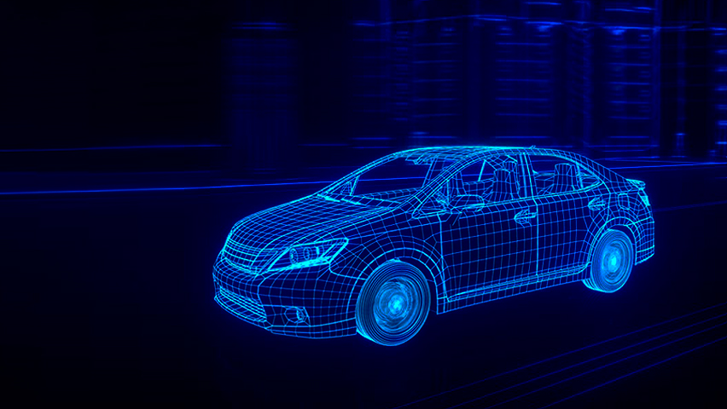
Car Control Application
Need Findings

Slide 2

Overall Purpose and Goals
Present the results of the Requirement Analysis
Characterize the Persona and the respective app use Scenarios
Identify the key Requirements
Show the app’s Prototype

Slide 3


User characterization through Personas
Philip, a 41-year-old man living in California, is a successful economist, married to Rachel, 39, and father of 2 children, 7-year-old Ross and 18-year-old Joey. Philip is a very busy man, and now, with the luck of being recently promoted, he values his time more than ever. Making a constant effort to always manage his time in the best way possible and to not waste time on unnecessary things, he always puts family first, spending most of his free time with them. Given his professional area, Philip looks a lot at the financial side of things and tries to save where he can. The option of buying an electric car came when he realized that it would bring his family economic benefits as well as an ecological added value, all with the matter of comfort already guaranteed. Having spent a considerable number of years driving second-hand cars and finding some problems related to this, he decided to buy a first-hand electric car. Philip turned out to be very pleased with his new acquisition, finding the features of his new car excellent, and some of them even innovative for his eyes. Passionate with the modern electrical world, Philip wondered if there would be an application that would complement his new car, making his interaction even more efficient. Access to some car features through a mobile application, such as the air conditioner and even the alarm, seems very interesting and revolutionary for a person like him.

Slide 4
Context of Use through Scenarios
1 Scenario: Philip is 15 minutes away from finishing a long day at work. Since it is the middle of Winter and one of the coldest days of the year, he would love not to have to go through the pain of having to get to his car breathing the freezing cold air and to encounter his car even colder than he had imagined. With that in mind, Philip, with the help of a smartphone app, would like to activate the air conditioning of his car without actually being inside of it, so when he arrived there he would not have to close his coat even more and would actually feel comfortable.
2 Scenario: To better enjoy his free time, Philip decided to go with his family and get to know a new city. There, they decide to go to a big shopping center that they came across. The owner of the car, his wife, and his children liked this center very much, but they encountered a problem when it was time to leave. Since they were in a unknown city and the mall’s parking location was so large, none of the members of his family remembered where they parked the car. At the time, Philip liked the idea of his mobile app somehow helping him locate his car.

Slide 5
Context of Use through Scenarios
3 Scenario: To ensure that his recent investment is not easily lost due to a car theft or any damage done to it, Philip also imagined having his mobile application warning him of any suspicious activity being carried out on his car. An option would be to receive a notification if the car’s alarm system went off.
4 Scenario: Philip has not yet become accustomed to the operation of the battery of his new car. Still having difficulties in analyzing status specifications such as how many kilometers can he still drive before the battery runs out, he finds very useful to know this to be more confident before going on a trip or just leaving his office to home or somewhere else.

Slide 6
Requirements Identification from Scenarios
A first time user must be able to connect his car to the App in less than 5 mins
A user must be able to:
know the car autonomy in less than 1 min
activate the air conditioning system in less than 1 min
make sure his car is locked in 30 secs
evaluate the car status at any time in less than 2 mins
Less than 25% of the users should have difficulties in grasping the app’s main features
Any user must have access to online help at any time.

Slide 7
Features that Philip is looking for in an application to control his car -
set the car temperature
locate your vehicle
check your car's vital information and be notified in case of security breach in your vehicle
seeks to increase your comfort through a mobile application that allows you to interact with your new car
wants the application to be intuitive, basic and quick to use

Slide 8

Paper prototype
Paper Prototype Based on the persona created, the usage scenarios of the same and the requirements collected through it, we created a low-fidelity prototype. The objective of developing this prototype was to allow a more detailed analysis of the functional issues related to the application to be made. Being made on paper, it allowed changes to be made to the application structure quickly.

Slide 9
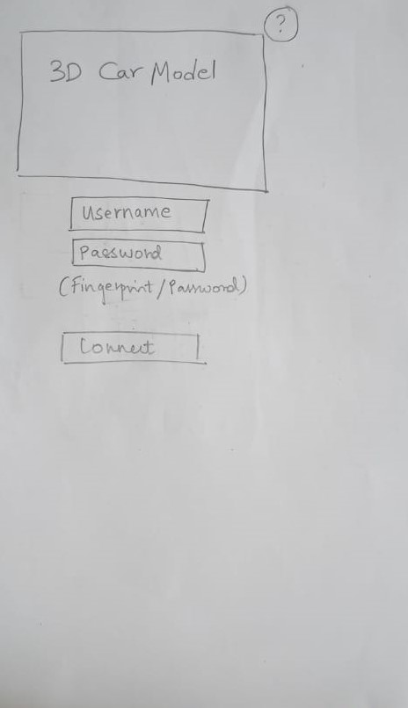
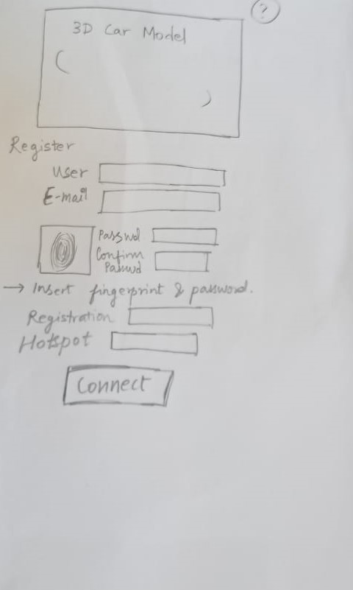
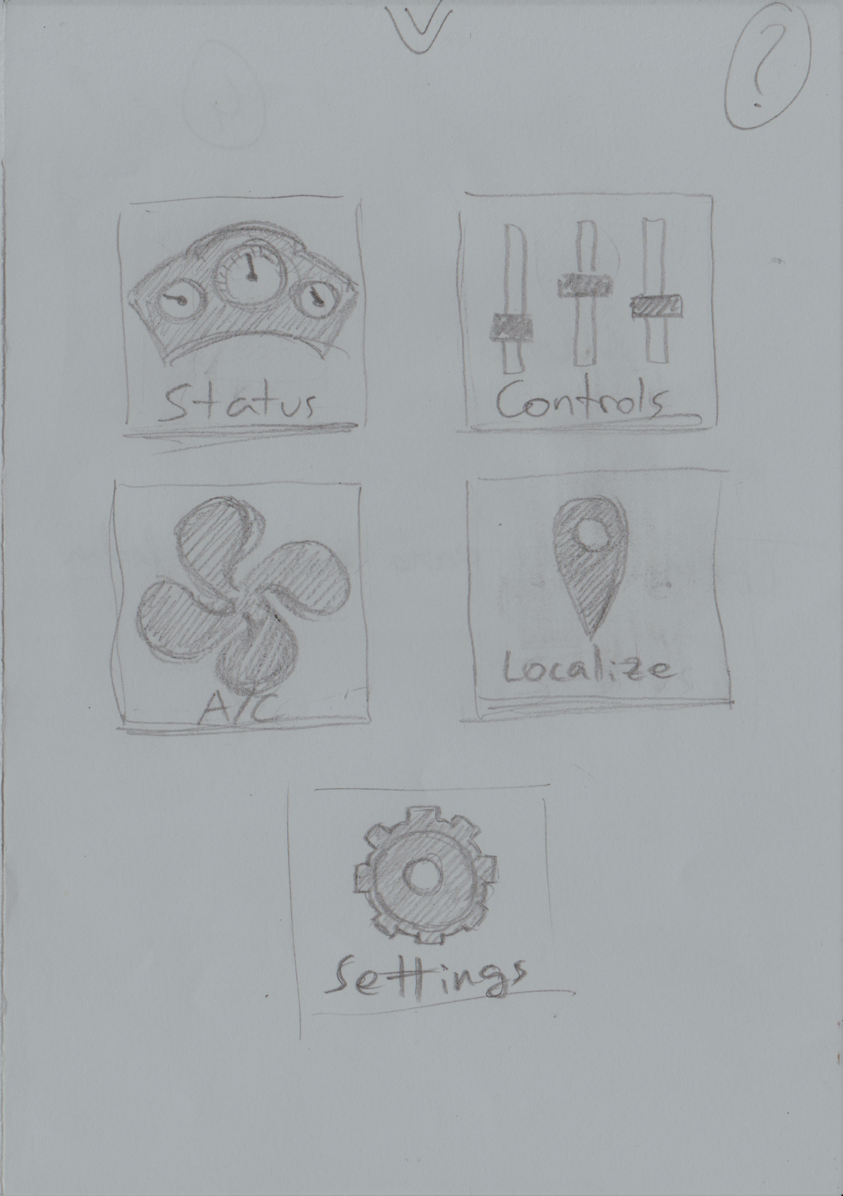
Conceptual Validation using a Paper Prototype

Slide 10
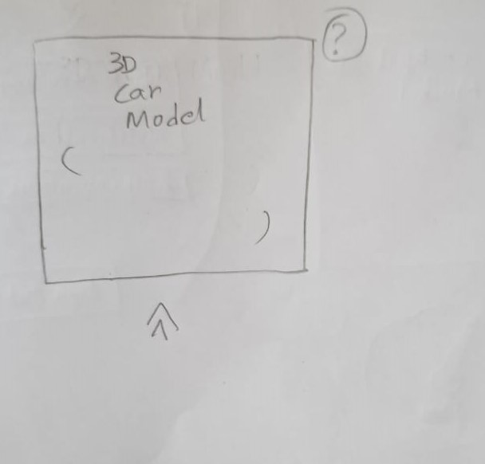
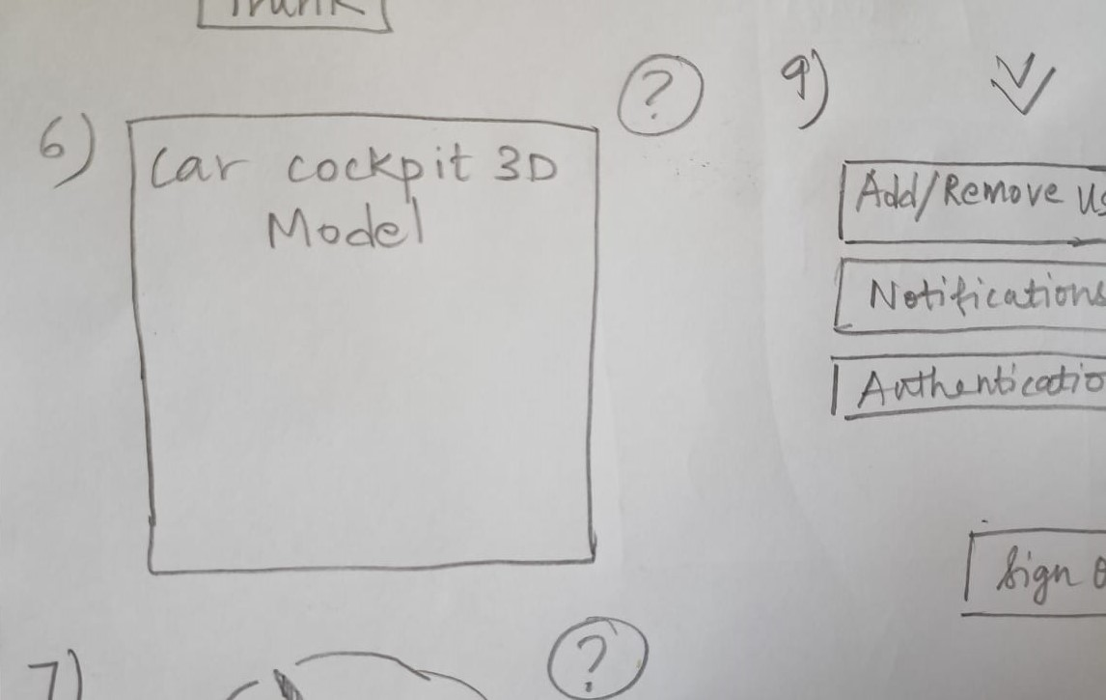
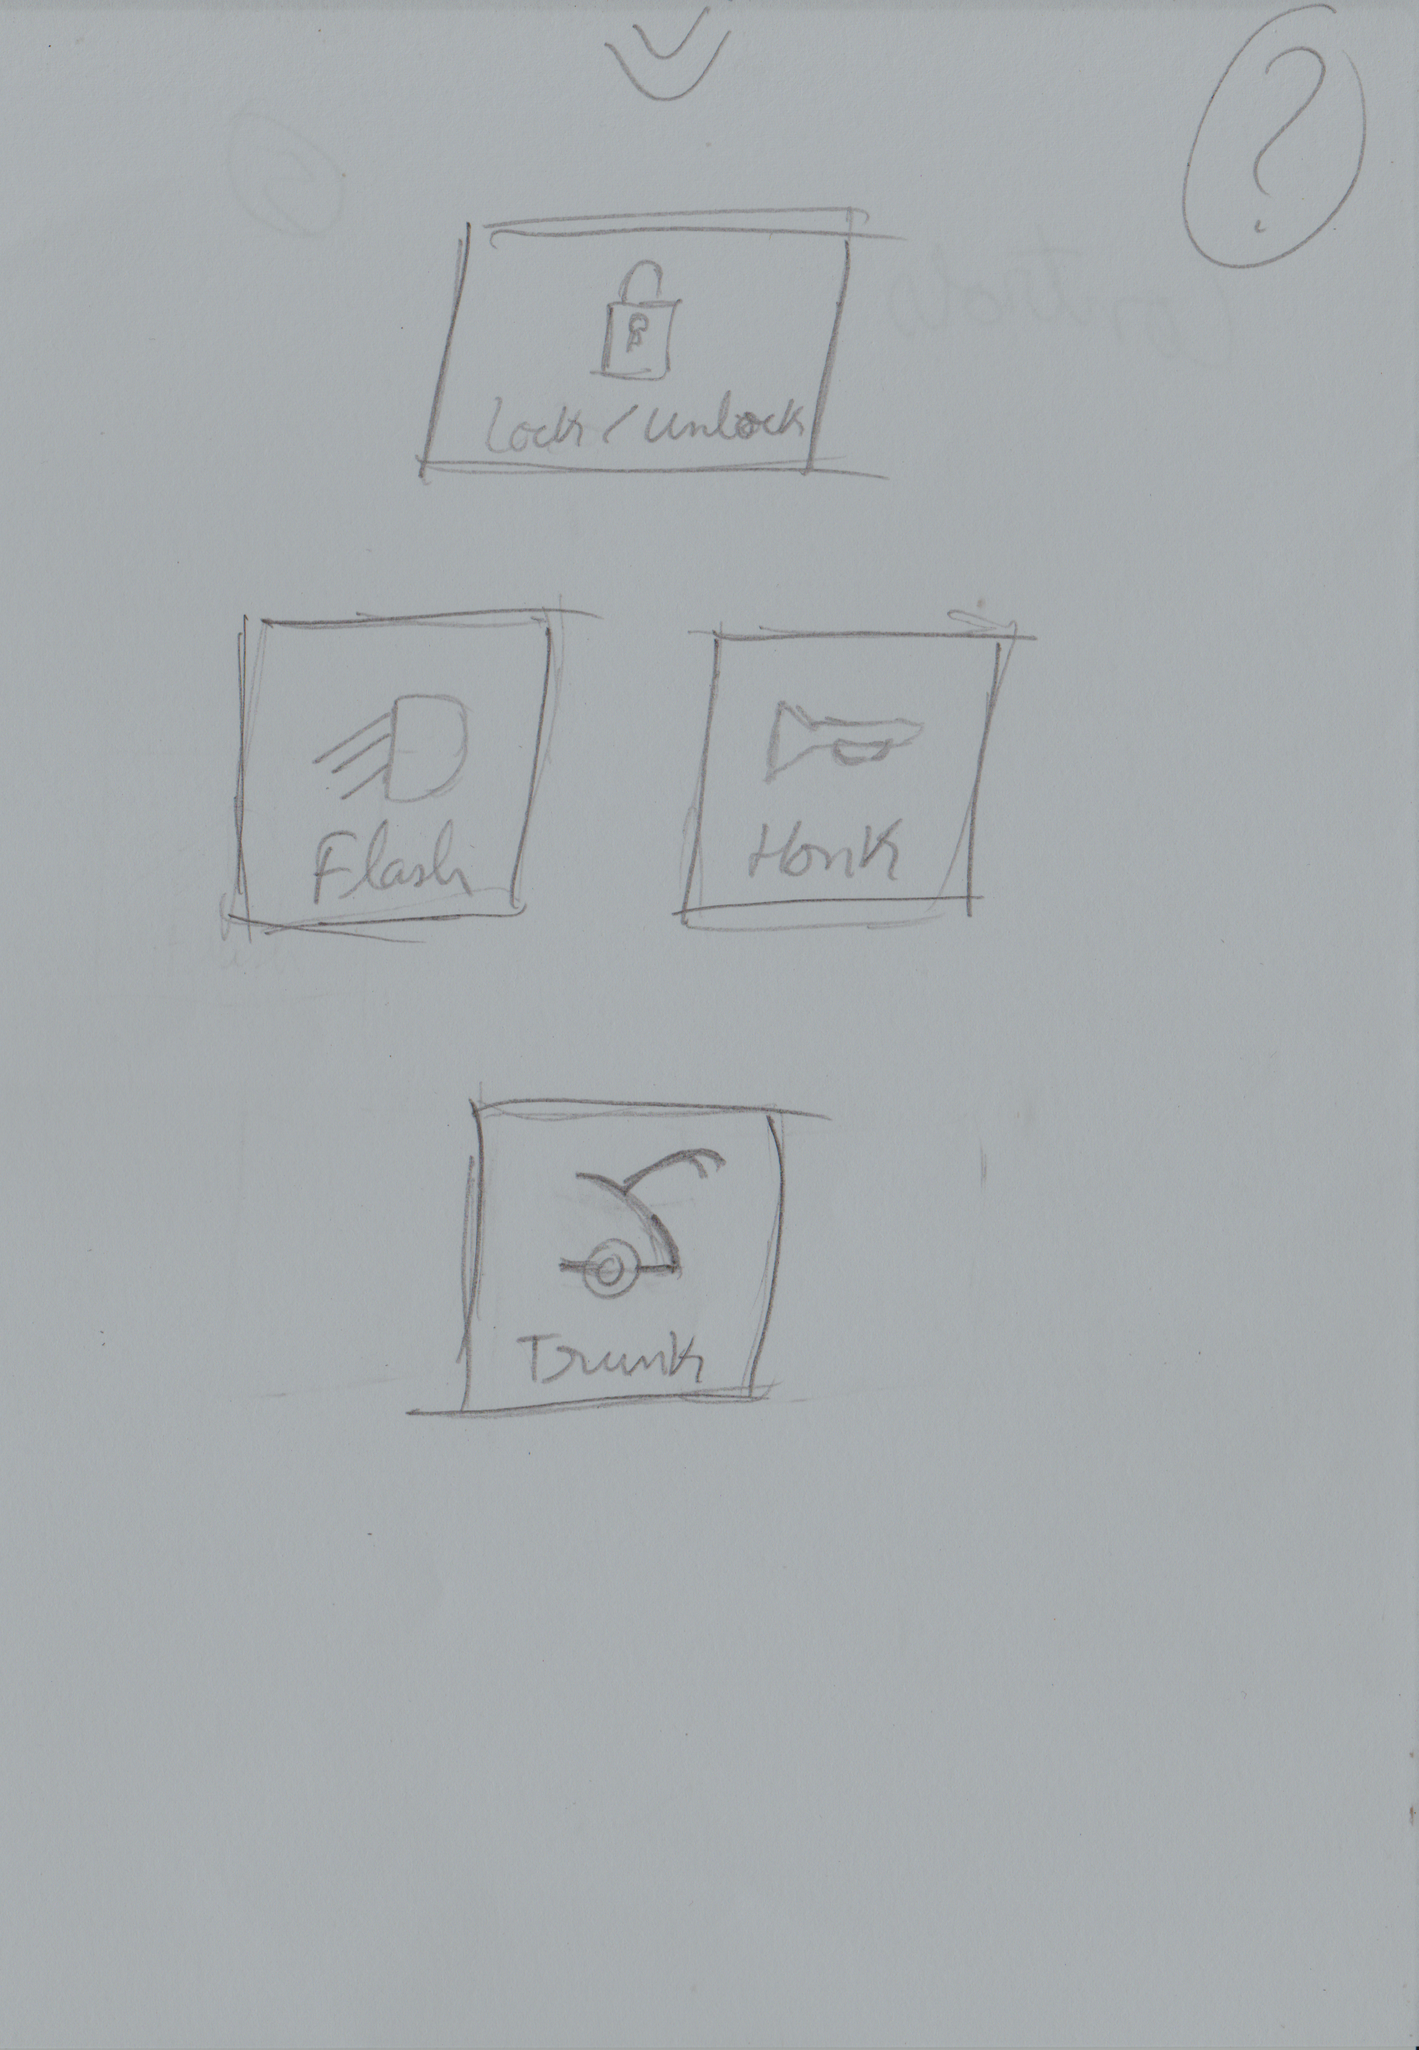
Conceptual Validation using a Paper Prototype

Slide 11
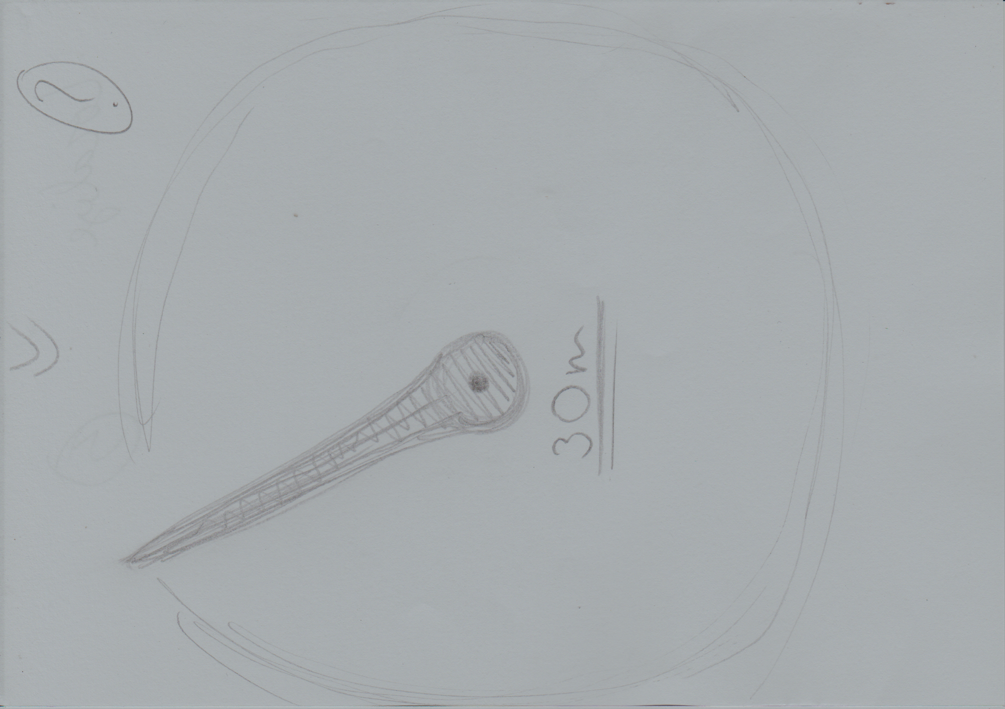
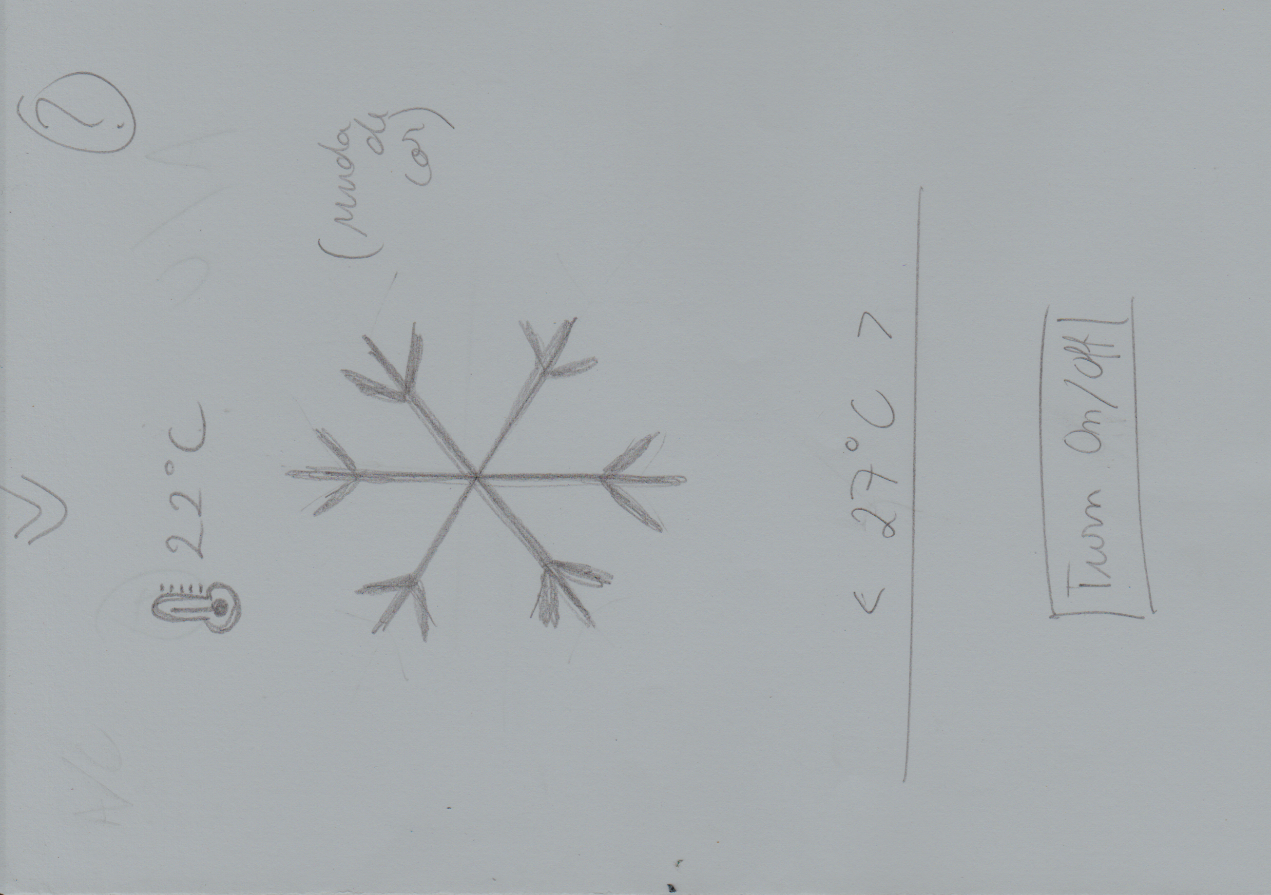
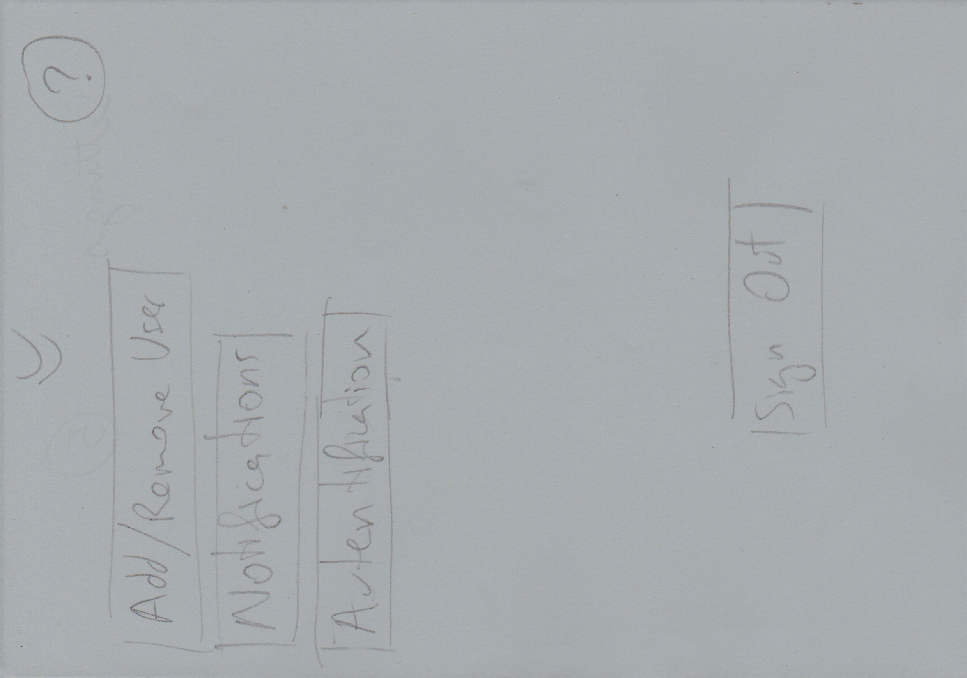
Conceptual Validation using a Paper Prototype

Slide 12
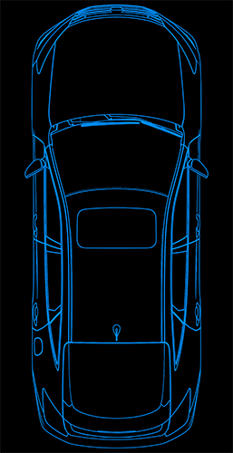
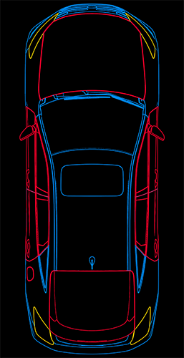
Car Control App – V1.0
Use of Android Studio tool, as it is a mobile application
Almost direct implementation of the paper prototype after necessary changes
It seeks to establish a modern and appealing design without compromising it’s functionality

Slide 13
Usability Testing
Usability Test Results:
- Satisfactory Application in general, however containing some inconsistencies
- Visually very consistent and Appealing
Problems to solve:
- Make navigation through the application more direct
- increase the prominence of the most important components
- increase feedback on the execution of actions
- improve the quality of the information made available
- correct the use of some technical terms

Slide 14
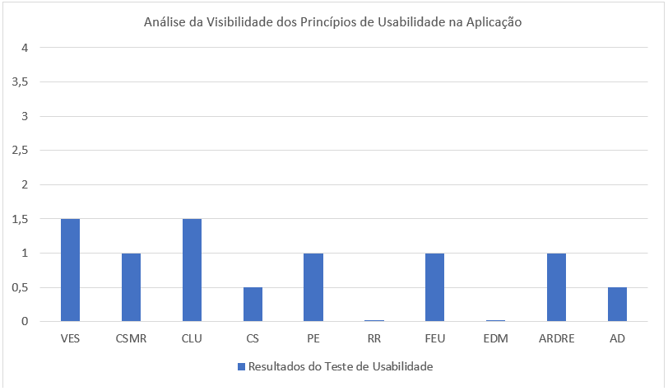

Usability testing

Slide 15
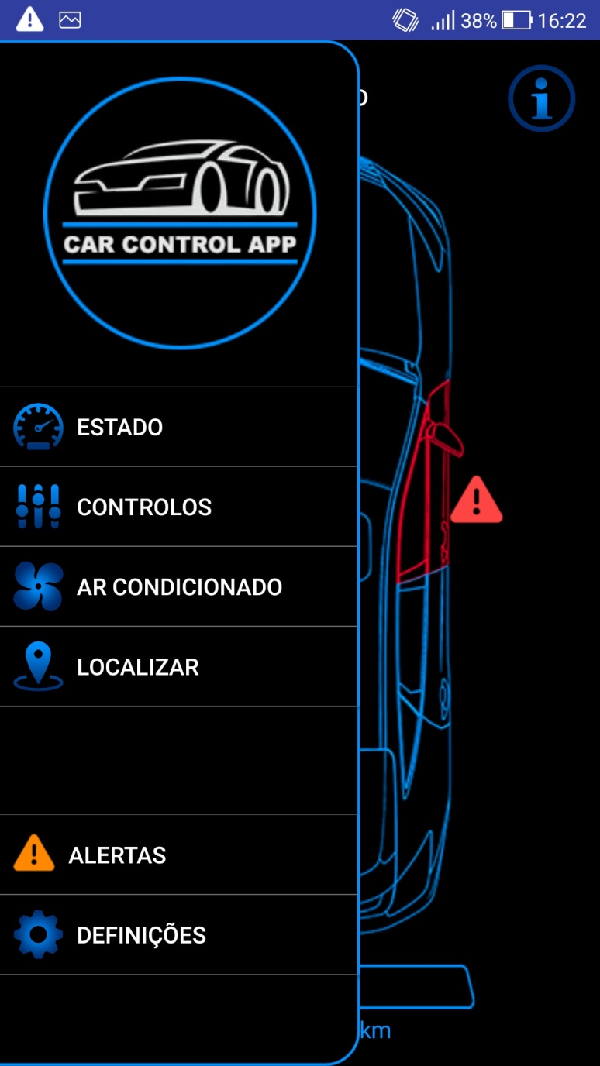
Car Control App – V2.0
Introduction of new components for more intuitive and fluid navigation
Constant user feedback of your actions
Final touches to consolidate a robust implementation
CONDITION
CONTROLS
AIR-CONDITIONING
TO LOCATE
ALERTS and DEFINITIONS

Slide 16
Future works and conclusions
Associate the application with an electric car company, taking into account aspects such as -
Improving the functionality of receiving notifications whenever a risky situation occurs in the vehicle
permission to access the car's location
creation of a database for users of the application
guarantee of security in the use of the application

Slide 17

The End

